Slide 1










Slide 2

Objective
The project's goal is to forecast the profit and loss of an investment in any Nifty 50 firm based on the purchase date, selling date, and quantity of shares purchased of that particular stock.

Slide 3
About Nifty - 50
The NIFTY 50 is a benchmark index in the Indian stock market that reflects the weighted average of 50 of the top Indian firms listed on the National Stock Exchange. It is one of India's two primary stock indexes, the other being the BSE SENSEX.

Slide 4




Vinayak Goyal
Ahmad Geelani
Jayashree Patra

Slide 5

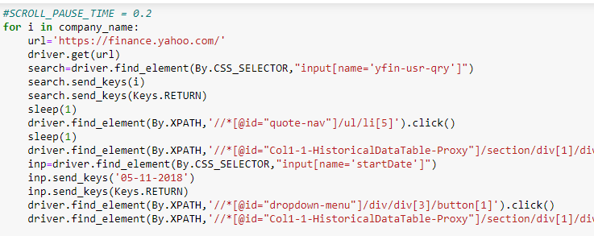
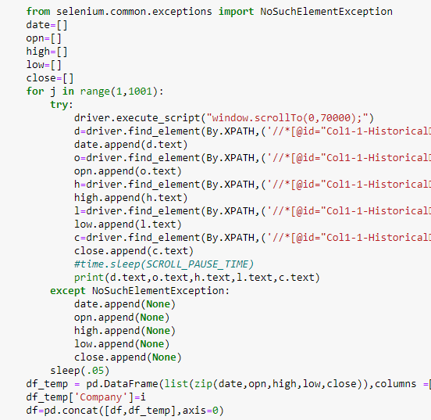






Data Scrapping
Using Selenium

Slide 6

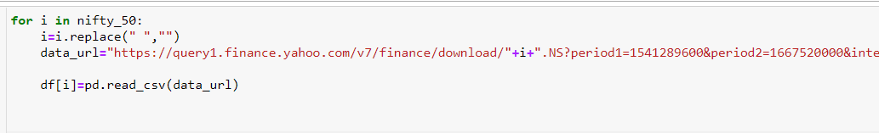
Using Beautiful Soup

Slide 7
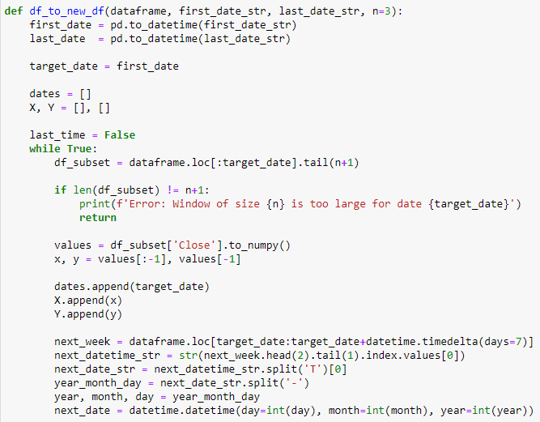
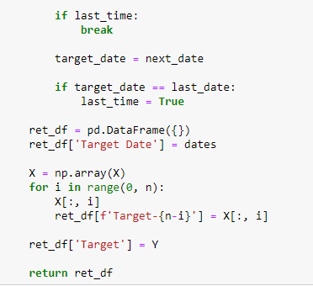
Forecasting

Slide 8
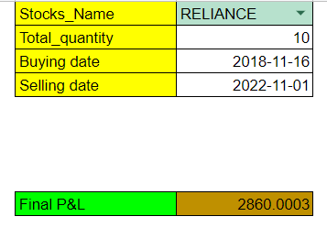
Spreadsheet

Slide 9
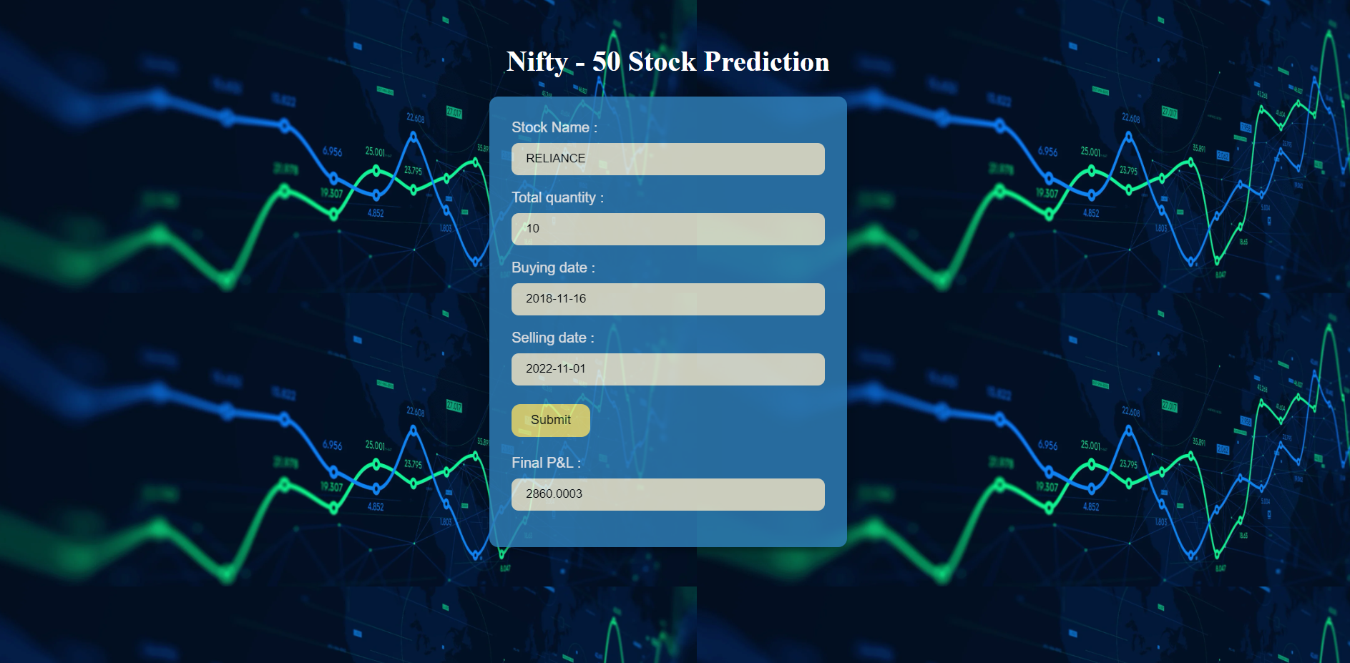

Slide 10





Challenges
Scrapping the data.
Comprehending time series data for forecasting.
Connecting spreadsheet to html

Slide 11



Slide 12


